Slide 1
To Do list webpage
By Nick and Jacob

Slide 2
Purpose
This webpage was created to make a clear environment for the user to create, view and delete their tasks.
this will allow them to complete tasks in an organised fashion due to the practicality of our web page.
Users can also select multiple tasks as completed before deleting them which can serve as a way for the user to see their progress in completing their tasks.

Slide 3
Technologies used:
Our webpage has been programmed on vscode. We have used HTML in order to display the tasks and all of the inputs needed to create a task, The functions required for the to do list were coded using javascript and CSS was used in order to style the application.
We also used github as an easy way of working on the code remotely, saving any changes we make to a shared project.

Slide 4
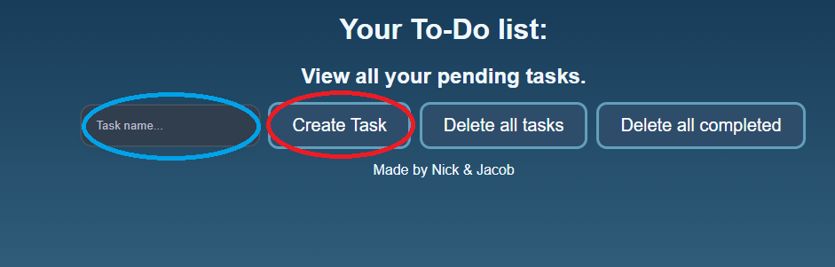
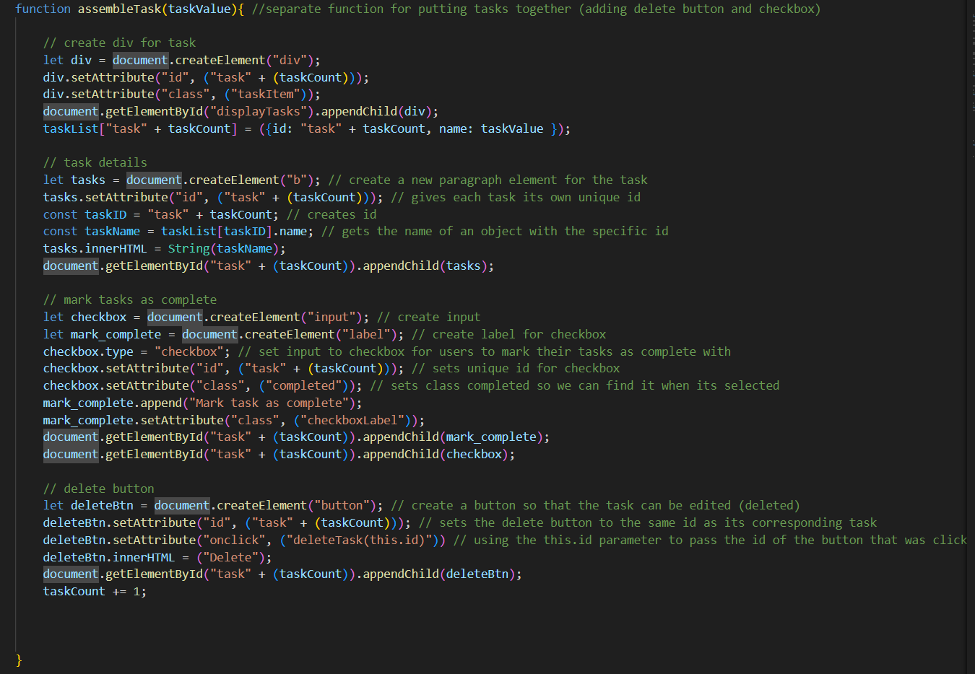
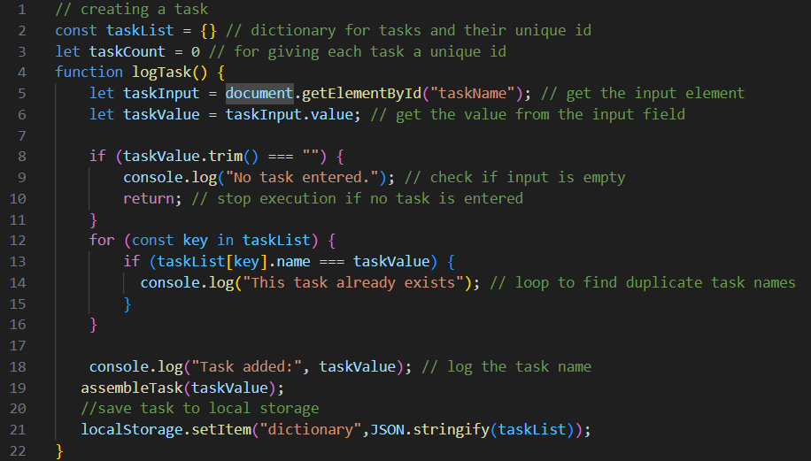
Live demo: Adding a task
In order to add a task, a user must first enter the name of the task into the search bar, then press the “create button”, this will run the “logTask()” function. All tasks are saved to an object with their own unique id.
A separate function called “assembleTask()” has been created to combine a task with a checkbox and delete button.

Slide 5
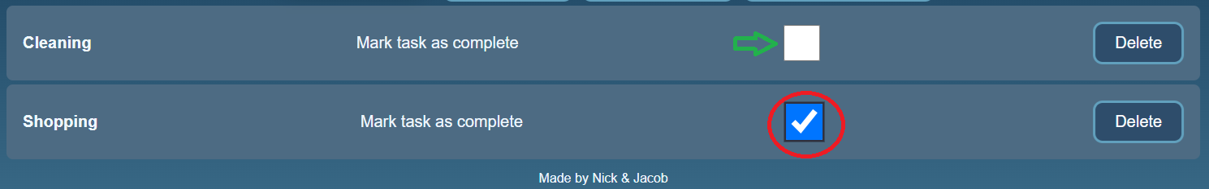
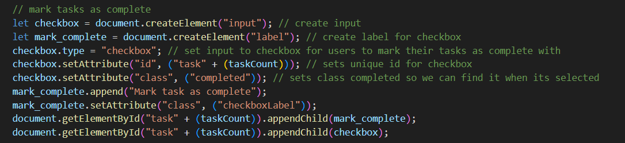
Live demo: checkbox
Once a user completes a task, they can use the built in checkbox to mark the task as complete, this will add a tick to it to differentiate it from incomplete tasks, the user will also be able to delete all tasks that have been marked as complete

Slide 6
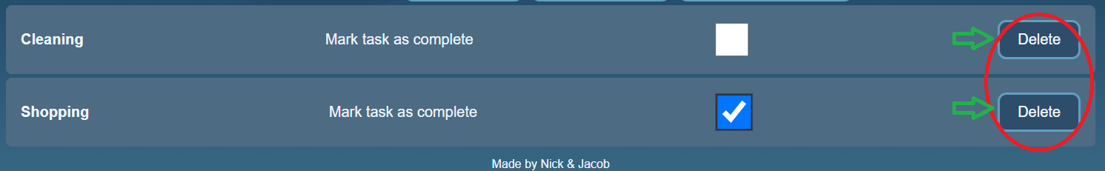
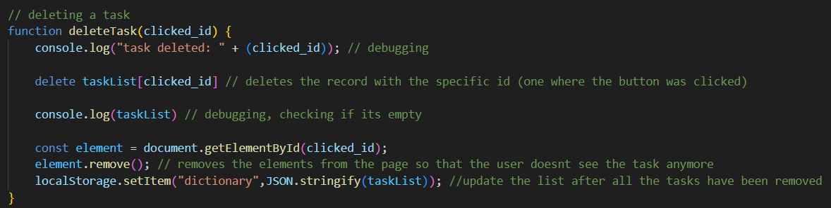
Live demo: deleting a single task
Since each task will display with its own delete button, users can quickly delete singular tasks, pressing the button will call “the deleteTask()” function.

Slide 7
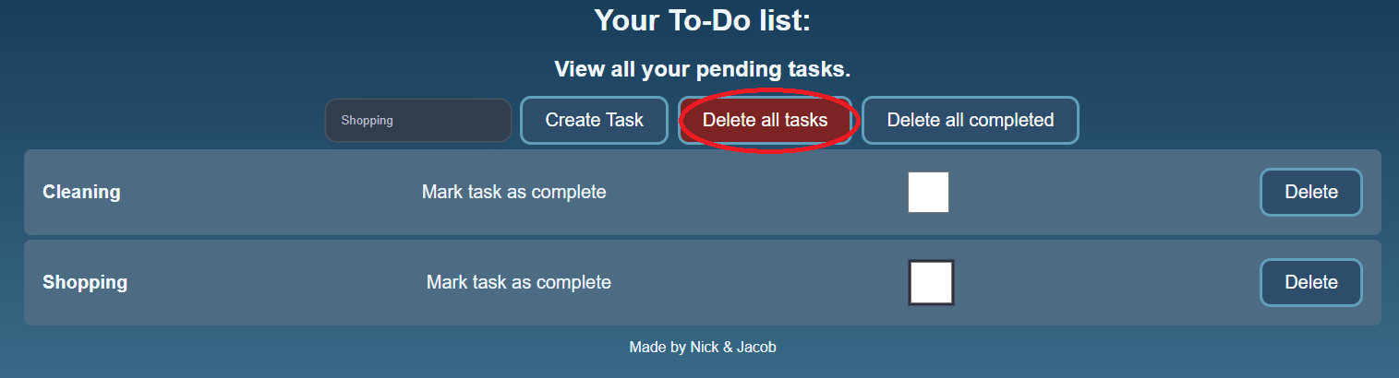
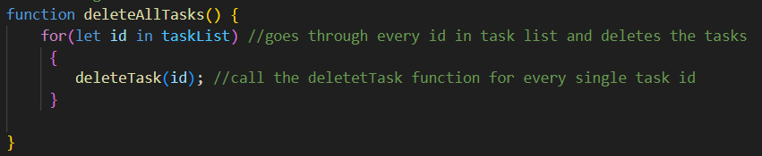
Live demo: deleting all tasks
The main interface includes a delete all task button, this will delete every single task on the screen. This button calls the “deleteAllTasks()” function which is simply just calls the “deleteTasks()” function for all tasks instead of just one.

Slide 8
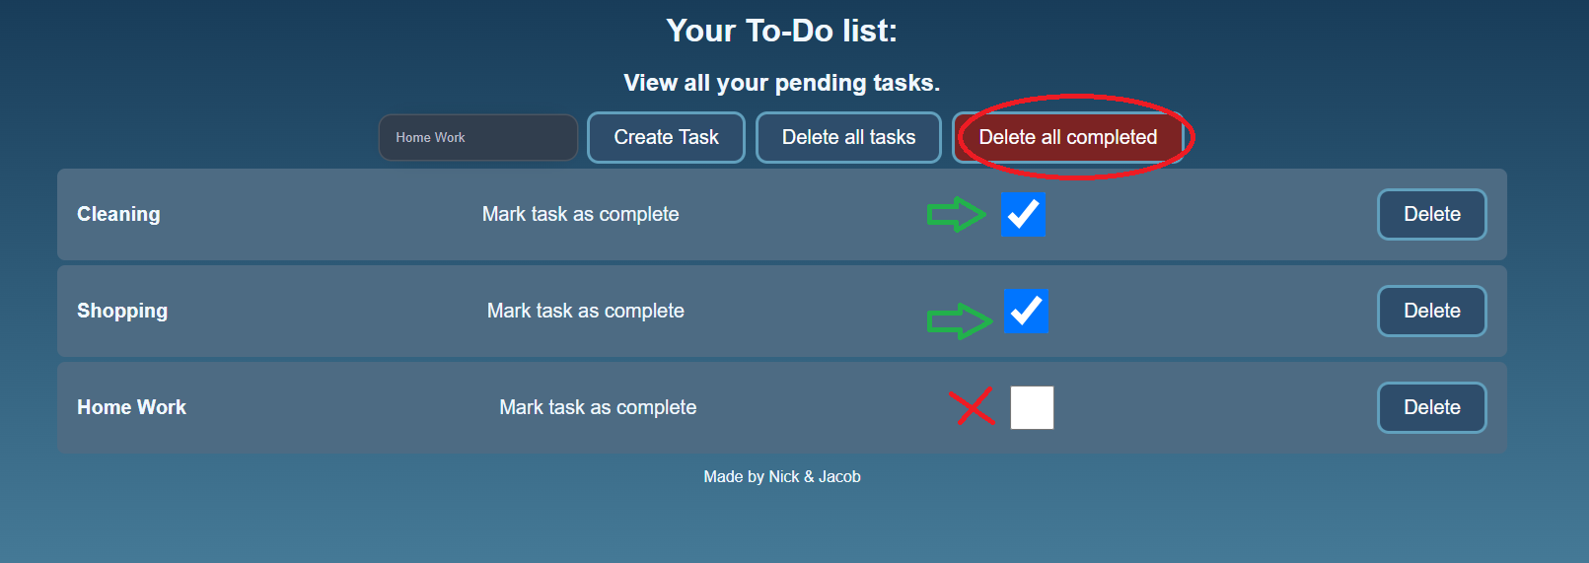
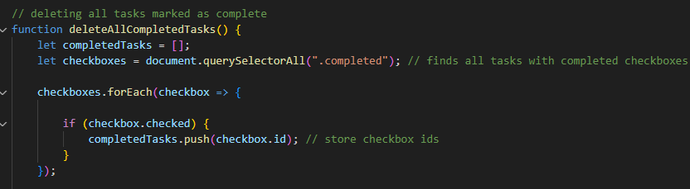
Live demo: deleting all completed tasks
The delete all completed button will delete any tasks that a user has marked as complete using the checkbox. This button calls the “deleteAllCompletedTasks()” functions, which checks if a task’s checkbox is clicked before deleting.

Slide 9
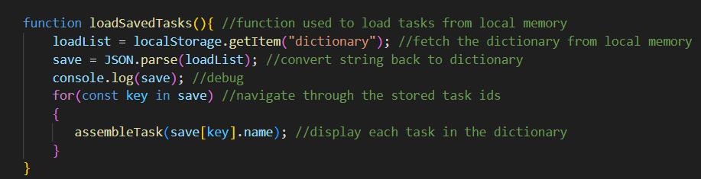
Saving Tasks:
All tasks are automatically saved to local storage, the “logFunction()”, “deleteTask” and “deleteAllCompletedTasks” all save the dictionary storing the tasks on screen to local storage, so every time a task is added or deleted the current version of the dictionary is saved and overwrites the previous one.
A function called “loadSavedTasks” will run every time the website loads and will use the assembleTask() function to display each task that has been stored in the saved object
The line of code used to save the object

Slide 10
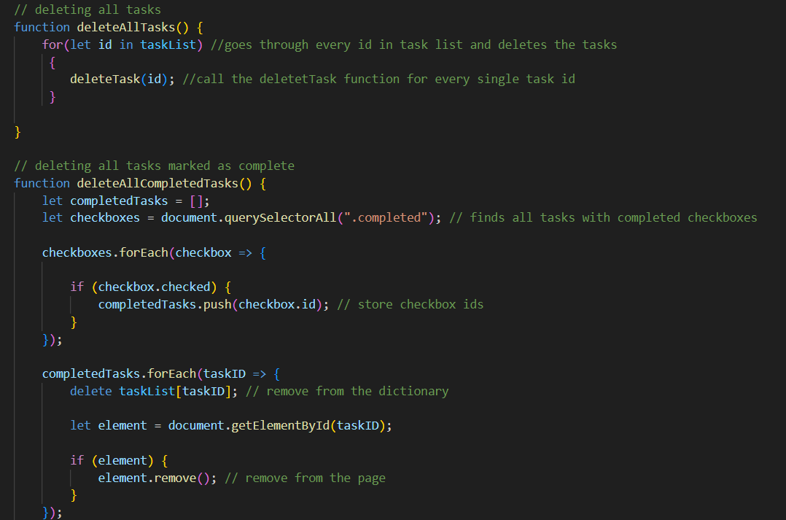
Development process: code structure
We stored the javascript code in a separate js file which is linked to the html file. We also separated each part of the to do list into their own functions, which makes the code more efficient as we were able to reuse a function if needed.

Slide 11
Challenges we faced
One of the first challenges that we were hit with was the deleteTask() function. This is because of each task being assigned a unique id, this id was linked to an item inside of an array which stored the names of all the tasks which meant when a task was deleted the order of these ids and the names they correspond to no longer matched properly.
To fix this, we changed the array to an object which allowed us to store the names of tasks and their unique ids, this meant that the tasks id would always remain linked to that task name.
This then allowed us to properly delete the correct tasks.

Slide 12
Challenges we faced
Another challenge we faced was finding a good design for the CSS in order to make the webpage look better. We overcame this by creating a simple design that looked decent which we can create with our current CSS skills.

Slide 13
Lessons learnt:
While we were creating this app, we were able to improve our javascript skills and gain the ability to create more complex functions. We also learnt how to collaborate effectively over a long distance using applications such as github to quickly send any progress made to the other user.

Slide 14
Future enhancements
Potential Features:
Add the ability to give tasks a description to make a user’s task clearer
Improved CSS, (i.e more complex and detailed background, greying out complete tasks etc)

